Slide 1
Classification & Taxonomy

Slide 2
Classification and Taxonomy
Classification- process of dividing organisms into groups with similar characteristics
Taxonomy- the science of classifying living things
Taxon- any particular group within a taxonomic system

Slide 3
Dichotomous Key
Dichotomous Key- tool used to identify organisms using their characteristics
Characteristics are given in pairs
Read both characteristics and either go to another set of characteristics or identify the organism

Slide 4
Magnolia
Elm
Walnut
Spruce
Pine
White Oak
Chestnut
Holly

Slide 5
Development of Taxonomy
A natural way of classifying organisms is based on the way organisms look and how they live
About 2,400 years ago, Aristotle classified organisms into only two taxa-plants or animals
Swedish botanist Carolus Linnaeus developed a classification system based on structural similarities during the 1700’s

Slide 6
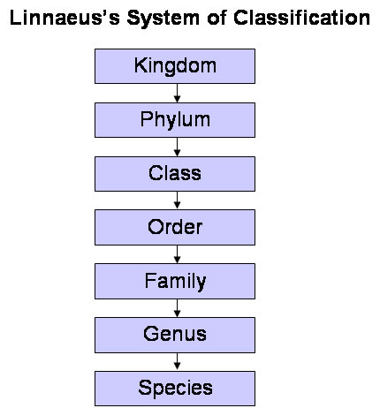
Development of Taxonomy
Linnaeus divided all organisms into two major groups called Kingdoms, which he divided into smaller and smaller groups
Less Specific
More Specific

Slide 7
Development of Taxonomy
Domain- largest division of taxonomy, based on differences between prokaryotes and eukaryotes, ex. Eukarya
Kingdom- second highest taxonomic rank below domain, ex. Animalia
Species- organism that are similar in structure and appearance, can breed successfully, and have the same number of chromosomes, ex. Sapien
Varieties or breeds- groups of slightly different organisms in the same species, ex. Golden retriever

Slide 8
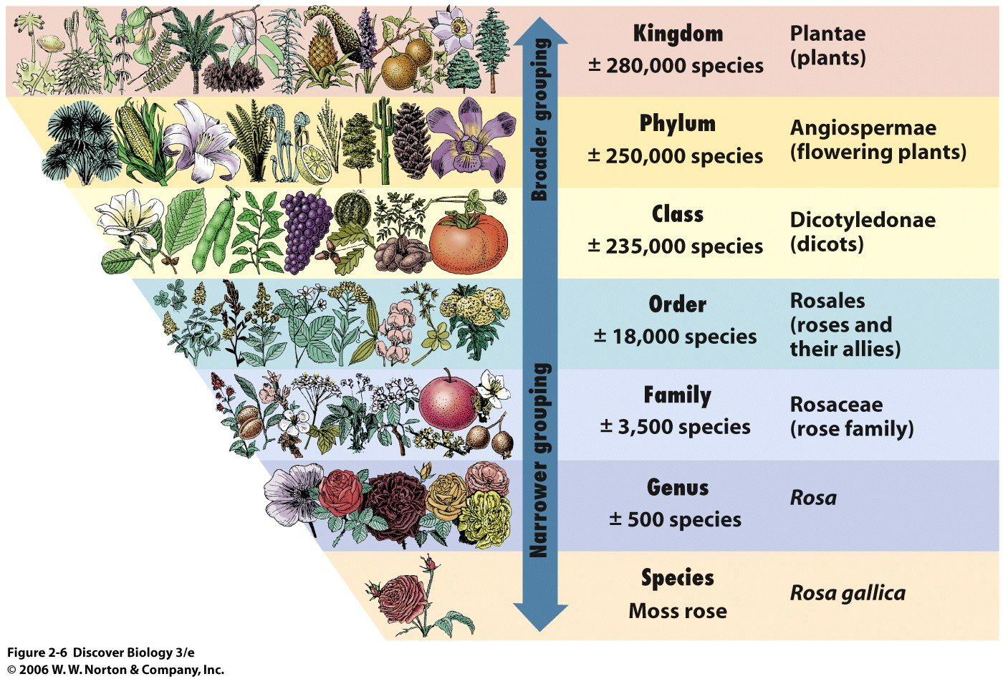

Slide 9
Binomial Nomenclature
Linnaeus also introduced a system of naming organism called Binomial nomenclature.
In binomial nomenclature the first name is the genus to which the organism belongs, the second name is the species name of that organism.
The GENUS name is capitalized; the species name is lower case.
Scientific names are always underlined or italicized. Ex. Homo sapien

Slide 10
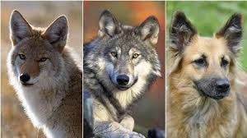
Binomial Nomenclature
Linnaeus used Latin names because:
It is the language of scientists around the world
It is studied and written, but not spoken
It is descriptive and the root of many other languages
Examples of scientific names:
Canis familiaris→ domestic dog
Canis lupus→ wolf
Canis latrans→ coyote

Slide 11
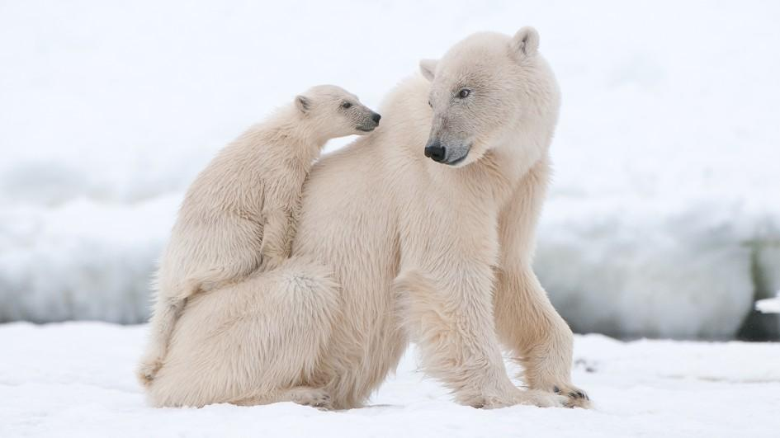
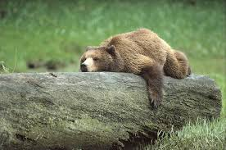
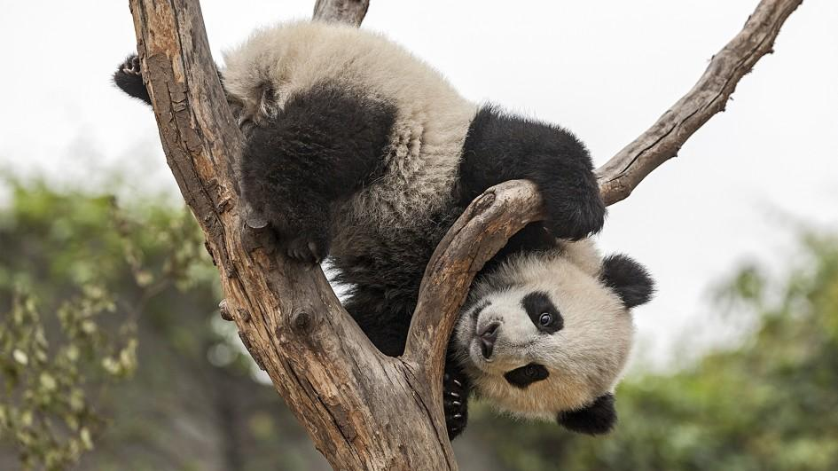
Which two are most closely related?
Polar Bear→ Ursus maritimus
Grizzly Bear→ Ursus arctos
Giant Panda→ Ailuropoda melanoleuca

Slide 12
Common Names
Common names are confusing because:
The same organism may have many common names. Ex. Felis concolor, common name- cougar, mountain lion, puma, panther
Common names are misleading. Ex. A jellyfish is not a fish, but a seahorse is a fish
Common names vary with different languages. Ex. Chipmunk- Streifenhörnchen (German), Ardilla (Spanish), 花栗鼠 (Chinese)

Slide 13
Modern Taxonomy
Modern taxonomy is based on genetic similarities and the theory of evolution.
If two organism have the same number of chromosomes and the chromosomes are similar in form, then the organism are closely related.
The greater similarities in DNA, the closer the relationship between organisms.

Slide 14
Three Domains
Domain Archea- (Kingdom Archeabacteria) prokaryotic organisms that live in extreme environments; halophiles (organism which thrive in highly salty environments), and hyperthermophiles (organism which thrive in extremely hot environments) are examples
Domain Bacteria- (Kingdom Eubacteria) common prokaryotic organism found almost everywhere; bacteria (heterotrophic carbon-eating prokaryotes) and cyanobacteria (autotrophic photosynthetic prokaryotes)
Domain Eukaryote- eukaryotic organism that are most of the world’s visible living things; kingdoms Protista, Fungi, Plantae, and Animalia are examples

Slide 15
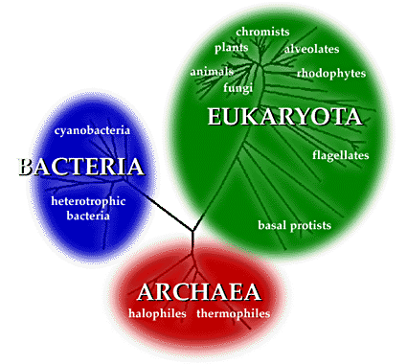

Slide 16
Four Kingdoms of Domain Eukaryota
Kingdom Protista- eukaryotic unicellular organism (cells have nucleus); protozoa and simple algae
Kingdom Fungi- multicellular eukaryotic organism that are plant like in structure but cannot make their own food; molds and mushrooms
Kingdom Plantae- multicellular eukaryotic organism which can make their own food through photosynthesis; plants
Kingdom Animalia- mobile, multicellular, eukaryotic organisms that ingest food; sponges, worms, fish, reptiles, birds, mammals

Slide 18
Phylogenetic Trees and Cladograms
Phylogeny- the study of evolutionary relationships or ancestral relationships among organism
Phylogenetic tree- a diagram showing how species are related to each other through common ancestors
Phylogenetic trees show which organism are extinct and which are still living. It also gives the relative times when the organism were alive.

Slide 19
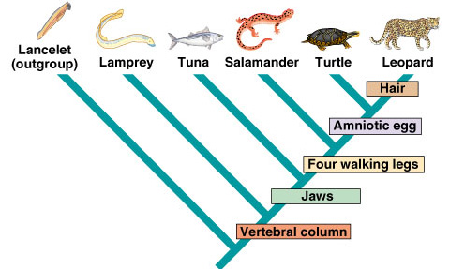
Cladograms
Cladograms- a diagram that depicts the degree of evolutionary relationships among organism, based on related structures and adaptations
Derived characteristics appear at branches of the cladogram showing where they first arose.
Cladograms DO NOT show the relative times that organism lived and do not show common ancestors.

